Slide 1
Taking A Fresh Look At Manufacturers’ Reps
Supporting the Needs of the Manufacturer

Slide 2
Taking A Fresh Look At Manufacturers’ Reps
Today’s Discussion
  A Look At The Current Market Environment
  Sales Channel Needs
    Manufacturers’ Reps Ability To Address Those Needs
  Next Steps
Notes:
Key Points
With all the change in our industry, it is worth some time for a manufacturer to take a fresh look at Manufacturers’ Reps. This is true for a manufacturer who successfully uses Reps today to be sure they are taking full advantage of the Rep model. It is true, as well, for Manufacturers that are not using Reps today.
We will look at the current market environment. We will look at what, we believe, Manufacturers need from their sales channels. And, we will talk about how Reps can address those needs.
The slides are designed to drive a discussion so let’s discuss as we move through this material.

Slide 3
Taking A Fresh Look At Manufacturers’ Reps
In Today’s Business Environment, The Ability To Adapt To Change And Efficiency Are Critical To Success.
  The Electronics Industry Is Very Dynamic, Yesterday’s “Hot Product” May Be Obsolete Today.
  Understanding Rapidly Evolving Customer Needs Is A Key To Success.
  Customers’ Expectations Of Sales Channels Continue to Grow: Service, Support, Low-Cost.
  Customer Multi-location Design, Purchase And Manufacturing Is Now The Norm.
  Increased Global Competition Is Adding Unprecedented Margin Pressure.
Today’s Manufacturers’ Reps Are Well Positioned To Take On These Challenges.
Notes:
Key Points
Today’s business environment is very dynamic – adapting to this change is a key to success.
Reps are well positioned to address these challenges.

Slide 4


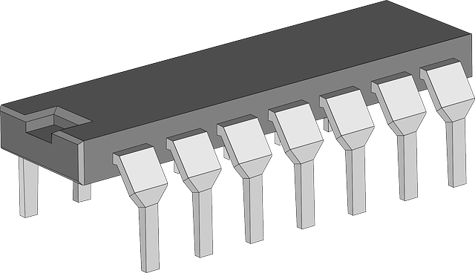
The Ideal Sales Channel Strategy?
Ideal Product?
Ideal Vacation?
Ideal Sales Channel?
Speed?
Package?
Temp Range?
Availability?
Low Cost?
Beach?
Mountains?
Relax?
Fly or Drive?
Romantic?
Family?
Cost?
Direct Sales Only?
Reps Only?
Hybrid Model?
eCommerce?
Global?
No One Perfect Answer… It Depends!
Notes:
Key Points
This slide is intended to show that when it comes to designing the ideal sales channel strategy this is no perfect answer. The ideal model depends on a lot of factors that will be different for each situation.
We use the analogies of an “ideal product” or an “ideal vacation” to show that there are always many factors and preferences to find the best solution.

Slide 5
Current Environment Is Very Dynamic
Customers
  As Always, Top Customer List Is Continually Changing (30-50% Change Over Five Years).
    Top Customers Move In / Out Due to Business Changes and Trends.
    Geographic Moves
    Mergers and Acquisitions
  Use of Third Parties (Design Houses, EMS Providers)
  New, Start Up Companies Emerging Every Day
Distribution
  Authorized Distributors Are A Valuable Element of The Support Model, But…
    Distributor Advocacy Of A Specific Manufacturer Is Often Limited.
    The Effectiveness Of The Traditional FAE Model Is Under Review By Both Distributors and Manufacturers.
    Even The Best Distributor FAE Resources Often Lack the Expertise and Time To Do The Job That Manufacturers Want.
Notes:
Key Points
Bullets are self-explanatory. Key point is that the environment is very dynamic with changes at customer and distributors.
Distribution remains a very valuable element of the support model – providing unrivaled fulfillment support. However, some elements of Distribution demand creation are under review by customers, manufacturers and distributors. With so many manufacturers on a typical Distribution line card it is difficult for a Distributor to fully meet the demand-creation needs of manufacturers or customers.
As a Rep it is important to emphasis the collaborative selling engagement with Distribution and how it works to support the manufacturers demand creation expectations.

Slide 6
Current Environment Is Very Dynamic
Manufacturers
  Manufacturers Want Control of Sales Resources Engaging With Customers.
  Manufacturers Value Flexibility To Adapt To Changes
    Market
    Customers
    Applications / Products
  Having A Direct Sales Team To Engage With All Targeted Accounts May Be Ideal But Not Practical For Most Manufacturers.
Emergence of eCommerce
  The Emergence of eCommerce Options (Manufacturer, Distributor, Third-Party) Have Changed The Support Model.
  eCommerce Does Not Eliminate The Need For Human Support Of Some Customers.
  Customers Expectations From The eCommerce Experience Continue To Grow From Simple Fulfillment Support To Comprehensive Application Expertise.
Notes:
Key Points
Bullets are self-explanatory.
eCommerce is a fact of life. However, the emergence of eCommerce portals has not eliminated the need for human resources to engage with customers.

Slide 7
Current Environment Is Very Dynamic
Personnel / HR
  Finding, Hiring, Training and Retaining Good Sales Resources Remains An On-Going and Costly Challenge.
  Ensuring That Sales Resources With The Right Skills Are in the Right Geography To Support Customers Is A Challenge.
  Overhead Associated With Maintaining A Direct Sales Team Is Significant
    HR Legal / Compliance
    Travel Expenses Turnover / Training
    Career Path
Notes:
Key Points
Important to highlight HR and Personnel issues with a direct sales team, in particular the issue of training and retention. With Reps, the manufacturers coverage needs are essentially met immediately post training. Reps know the customers and are in place in territory.

Slide 8


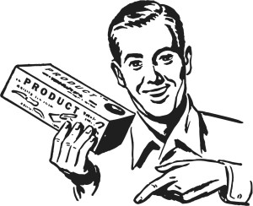
Today’s Manufacturers' Representatives – Modern Sales Professionals
Yesterday’s Manufacturers’ Sales Rep
( Post WWII -1960’s)
Tended To Be Smaller Organizations With Few Sales People
Lines Were Often More Opportunistic Than Strategic
Primarily Relationship Based Selling
Short Term Focused
Limited Sales Support Capabilities
Often Doubled As Stocking Distributor
Today’s Manufacturers’ Rep Organizations
Well-Trained (Certified) Technical Sales Professionals
Well-Financed Businesses – Long Term Focus
Strategic, Synergistic Non-Competitive Line Card Tailored To Support The Customer Base And Market
Focus Is On Design Development And “Pipeline Of Opportunities” For Sustained Growth
Positioned As “Trusted Advisors” To The Customer
Augment And Support Distribution
Solid Internal Customer Support, eCommerce And Lead Follow Up Process Capabilities
Notes:
Key Points
Consistent with our theme (Taking a Fresh Look at Manufacturers’ Reps), many people have a dated view of Reps.
In the past, many Reps were very small companies with few employees and few suppliers. Their focus was more on sales (rather than demand creation) and may have doubled as a stocking distributor.
Today, Reps are well-financed, well-trained companies that have a trusted role in their local markets. The focus is finding, developing and winning design opportunities across they entire breath of their manufacturer line card. Today’s Reps have a breath of resources to support the entire demand creation and sales processes.

Slide 9
Rep Model Description
What Is A Manufacturer’s Rep?
  A Rep Is An Independent, Local Company Able To Provide Comprehensive Sales Support, Especially Technical Sales, For A Limited Set of Complementary, Non-Competing Manufacturers.
  Reps Can Act As A manufacturers Exclusive Sales Team Or Supplement the manufacturers other Sales Resources
Key Attributes
  Long, Intimate Relationships With Local Customers and Distributors. (Reps Sell Where They Live.)
  Expanded Coverage Model Across Specified Territory With Multiple Sales Persons.
  Experienced Sales / Technical Professionals.
  Ability To Engage With Customer Across Multiple Technologies and Applications And At All Functions Within The Customer.
  Results-Focused (Minimal Corporate “Overhead” – Meetings, Reporting, Etc.)
  Often, A Rep Is In A Good Position To Have A Long-Term Focus Without Fear Of Global Fulfillment Migration.
  Inside Sales/Customer Support, Lead Fulfillment And Local Distribution Support Personnel.
  Get Paid Only On Sales.
Notes:
Key Points
Bullets are self-explanatory.
Key points to highlight
Reps are focused independent companies that represent a limited set of complementary, non-competing manufacturers.
Most Reps have, internal to their organizations, inside team of people who can handle customer service, lead follow up and Distribution support
Most Reps have long, intimate relationships with the local customers and distributors.
Reps are highly motivated to sell as they only get paid when customers buy something.

Slide 10

Model For Today’s Discussion
Issue / Assessment Criteria
Strong
Key Manufacturer And / Or Customer Needs
What Are The Key Sales Channel Needs For This Assessment Criteria?
Direct
Rep
Rep Ability To Meet Those Needs
How Can The Rep Model Address Those Needs?
Distribution
Weak
Thermometer Showing The “Relative” Ability Of Sales Channels To Address This Issue
Notes:
Key Points
This slide is intended to describe the model that will be used for the next few slides. Each of the next slides will show four things:
Highlight an important Manufacturer or Customer Issue or Assessment Criteria, e.g. Advocacy, Expertise.
Outline our understand of what the Manufacturer or Customer Needs.
Outline the ability of a Rep to meet those needs.
The thermometer on the left is intended to show the relative ability of various sales channels to meet the manufacturer / customer need.
IMPORTANT – The thermometer is intended to drive discussion. This is NOT a perfect answer.

Slide 11
Advocacy of a Manufactuers
Products With Customers
Strong
Key Manufacturer Needs
Active And Effective Advocacy Of Manufacturers’ Products To Multiple Customers In Current And Developing Markets.
Direct
Rep
Rep Ability To Meet Those Needs
With Complementary, Non-competing Products, Reps Are Able To Advocate A Manufacturer’s Products To All Customers And Distributors.
Due To The Breadth And Nature Of Most Distributor Line Cards It Is Difficult For A Distributor To Actively Advocate Any Single Manufacturer’s Products.
Distribution
Weak
Notes:
Key Points
Key need – Manufacturers want sales resources to “advocate” their product with customers.
Reps are well positioned to do this due to their limited, complementary, non-competing line card.
The thermometer suggests that
Direct sales drive the highest advocacy due to the nature of their job and limited options.
It is difficult for Distribution to adequately advocate any one manufacturer’s products due to the breath of Distributor line cards

Slide 12
Manufacturer Control and Influence
On Selling Resources
Key Manufacturer Needs
A Manufacturer Wants A High Level of Control and Influence On The Priorities and Activities Of Selling Resources.
Strong
Direct
Rep Ability To Meet Those Needs
The Collaborative, Contractual Relationship Between A Manufacturer And A Rep Gives The Manufacturer High Levels Of Influence.
With Relatively Few Manufacturer Partners, Reps Are Greatly Motivated To Perform For Each Manufacturer.
The Rep / Manufacturer Model Tends To Be:
  Strategic Around Long-term Customer And Market Relationships.
  Open To Long-term Investment And Support.
  Targeted At Long-term Roi.
Reps Only Get Paid Based On Sales Which Keeps Reps Focused On Results Not Activities.
Rep
Distribution
Weak
Notes:
Key Points
Key Manufacturer need – control and influence on priorities and activities of selling organization.
Reps are well positioned to address this need given the relatively few manufacturers that a Rep is contracted to support. And, since a Rep only gets paid for results there is a strong incentive to deliver results and not just “activities”
The thermometer suggests that a Supplier has the most influence over their own direct resources. Some Rep owners suggest that a manufacturer might have even more influence over Reps than they do their own people. Poor (or perceived poor) Rep performance almost always results in an immediate corrective action plan. Addressing underperforming direct resources can be a lengthy process And, underperforming direct resources continue to get paid a performance-independent base salary during this period. Some Reps would put “Reps” at the top of the thermometer.
Manufacturers often overlook the position their line has or will have in the Rep territory strategy, it makes the reps overall line mix that much more important to that reps customers. This inherently gives the manufacturer strong influence with that Rep firm.

Slide 13
Product Expertise
Key Manufacturer and Customer Needs
A Manufacturer Expects That Any Selling Resources Have Expertise On The Manufacturer’s Products And Typical Applications.
High
Direct
Rep
Rep Ability To Meet Those Needs
The Combination Of A Limited, Complementary Line Card And Experienced Technical Selling Resources Enables The Rep To Maintain A High Level Of Expertise.
A Complementary Line Card Gives A Rep Greater Exposure To The Entire Application Which Brings Value To Both Manufacturers And Customers.
This Expertise Is Enhanced By Rep Access To Manufacturers Technical Resources (Field Or Factory) To Address Complex Customer Issues.
Distribution
Low
Notes:
Key Points
Product expertise is a key need for both Manufacturers and Customers.
It is generally true that Direct Sales Resources have the most expertise in their own companies products. There are exceptions as there very experienced Rep technical resources and very inexperienced Direct technical resources. But as a general rule, Direct has the most expertise.
For similar reasons, Reps tend to have more expertise than Distributor salespeople and FAEs who have a very broad line card to understand.
One advantage that a Rep has over a Direct sales person is that the Rep has more involvement in the customer’s application / system. This broader view enhances a Reps ability to add value beyond simple device expertise.

Slide 14
Customer Experience
Fulfillment
Key Manufacturer and Customer Needs
Customers Need Timely Access To Off-The-Shelf Availability of Any Quantity Of The Correct Supplier’s Product At A Fair Price.
High
Distribution
Rep Ability To Meet Those Needs
Reps Combine Two Attributes To Support These Needs.
  First, By Teaming With Their Manufacturers, Authorized Distributors Reps Can Ensure The Right Product At The Right Price Is Designed And Adequately Pipelined.
  Second, By Having Access And Influence With The Manufacturer, The Rep Can Assist In Fulfillment Support.
Rep
Direct
Low
Notes:
Key Points
Note – the previous slides tend to focus on a “manufacturer’s” need. In this slide, we focus on a “customer” need. In this case, we are looking at the Customer Experience in Fulfillment.
Customers want to be able to find inventory of the right product at a fair price.
In this special customer need, the Sales Channel that best meets this need is Distribution. Distributors hold inventory of products for off-the-shelf sales to customers.
But, the Reps still play an important role in this customer experience. Reps make sure that the customer has designed in the right part that meets their technical needs and also meets their commercial needs (price and availability). Also, the Reps have good access and influence with their manufacturers to address fulfillment issues. Finally, since a Rep may be involved with many Supplies and technologies on a customer’s project, a Rep can bring enhanced value to Fulfillment issues.

Slide 15
Customer Experience
Demand Creation
Key Customer Needs
When Engaging With A Technical Sales Resource, A Customer Wants To Be Able to Discuss Several Devices and Manufacturers. And, The Customer Wants The Sales Resource To Be Very Knowledgeable.
Strong
Rep
Distribution
Rep Ability To Meet Those Needs
The Combination of A Complementary Line Card And Experienced Technical Resources Give The Rep Strength In Demand Creation Productivity.
Experience and Tenure Give Reps The Ability To Work With Customers Over Multiple Projects and Generations. Reps Work Where They Live.
Reps Also Have Effective Lead-Generation and Follow-Up Process To Find and Develop New Opportunities.
Direct
Weak
Notes:
Key Points
Again, the focus of this slide is a Customer need – customer experience in Demand Creation.
Customers want to engage with sales resources that can help them with their project by being knowledgeable across multiple technologies and suppliers. Ideally, those sales resources should have systems expertise that bring value to the customer.
In this case, Reps are uniquely positioned to bring value to customers. The combination of the Reps line card and their expertise in these products enable a Rep to contribute to Demand Creation at a high-level across many devices and technologies.
Demand creation though new customer pursuit is also a rep strong point as they drive lead follow up both directly and through the Distributor channel.

Slide 16
Full Market Coverage
Key Manufacturer Needs
In This Industry, New Customers Are Continually Emerging. A Manufacturer Wants To Be Able To Provide Effective Human Support Quickly.
Fast
Distribution
Rep
Rep Ability To Meet Those Needs
A Distributor Will Likely Have Available Resources To Provide A Base Level of Support To An Emerging Customer.
However, An Experienced Rep In The Market Is The Quickest, Best Option To Provide Full Customer Support. Often, The Rep Is Already Engaged With The Customer For Other Lines.
Direct
Slow
Notes:
Key Points
A manufacturer wants to be able to reach all customers – current and emerging.
Distributors are best positioned to meet this need as Distributors have relatively large selling teams in all markets. Distributors are well positioned to provide a base level of sales support to all customers.
However, an experienced Rep is able to provide comprehensive technical supports to customers in the Reps local market.

Slide 17
The Value Of Reps – The Distributors’ Perspective
Reps Bring Unique Value To Distributors As Well
Since A Rep Represents Multiple Suppliers, Interaction and Communication With The Distributor Is Simplified.
Reps Understand Distribution – They Know The People, They Know The Processes, Etc. Many Direct Salespeople, Especially New, Young, Technical People Do Not Fully Understand The Role Of Distribution In Supporting The Customer.
Reps Are Collaborative. At Times It Can Seem That Direct Salespeople Are Competing With Distribution.
Reps Are Focused On The Resale Price Only. Reps Do Not Decide A Manufacturer’s Cost To A Distributor. Reps and Distributors Are Not Competing For Transactional Margin.
Reps Often Have More Resources In A Local Market Than Any Specific Manufacturer. As A Results, Reps May Be More Responsive To Distributor’s Needs.
Notes:
Key Points
To this point, we have focused on the needs of Manufacturers and Customers. But, Distributors are another critical Sales Channel element. And, Distributors have needs that Reps are also well positioned to satisfy.
Working with Reps is often very efficient for a Distributor as a Rep has relationships with several Suppliers.
Reps understand distribution. Working with distributors is a key part of their day-to-day business. Reps tend to have experience, especially experience in the local market with local customers. Often, Direct salespeople do not have as much experience (or interest in) working with distribution.
Reps are focused on driving the resale price. Reps and Distributors are not competing for transactional margin.

Slide 18
Taking A Fresh Look At Reps
You may need to take a closer look at Reps if…
You Are Challenged To Reach All Of The Customers That You Want To Engage With Your Own Sales Team.
Customers May Not Naturally Go To Your eCommerce Portals Without Human Sales Interaction.
Distributors May Not Be Positioned To Actively Advocate Your Products To Strategic Markets And Customers.
You Are Concerned That Your Distributors Are Trying To Satisfy You And All Of Your Competitors At The Same Time.
Your Understanding Of What A Rep Can Do For Your Company Is From Years Ago Or From A Limited Experience With One Or Two Reps.
You Require More Flexibility To Adjust Local Customer Support As Customers Move, Grow Or Disappear. And, You Want Those Changes To Happen Quickly Without Delays Due To Hiring, Training and HR.
You Think Reps Are “Too Expensive.”
Notes:
Key Points
This is intended to be a summary / transition slide. We have walked through various Manufacturer, Customer and Distributor needs.
Now it’s time to suggest that Reps are worth a closer look.
Bullets are self-explanatory.
Again, this slide is intended to drive a discussion. People may disagree or question some of these points.

Slide 19
Important
The following two slides are intended to be used with a Manufacturer that is NOT using Reps today.
Remove this slide before presentation.

Slide 20
Making Manufacturers Reps Part Of Your Go-To-Market Strategy
Step 1 – Sales Channels Needs Assessment
Confirm And Prioritize What Are The Critical “Needs” Required From Your Selling Organization
  Where Are Those Needs Not Currently Being Met?
What Strategic Markets, Segments, Territories And Or Customers Are You Targeting?
  Where Is It Working And Where Is It Not And Why?
How Do Authorized Distributors Currently Fit Into Your Sales Strategy?
  Where Are They Meeting Your Needs / Not Meeting Your Needs?
  Do You Believe That They Are Actively Advocating Your Products?
Expectations In Demand Creation?
  Which Is Your Biggest Challenge – Finding New Opportunities Or Developing / Closing Designs?
  Is It Enough To Back Fill The “Churn” And Support Growth Moving Forward?
  What Are Your Expectations Of Your eCommerce Initiatives?
Cost Of Sales
  Are You Satisfied With The ROI On Your Sales Channel Investments Today? If Not, Why Not?
Notes:
Key Points
The next two slides are the “Next Steps” slides trying to get people to do a more comprehensive Sales Channels Needs Assessment. This slide and the next are to be used with Manufacturers that are NOT using Reps today.
What is outlined here is a proposed set of next steps to determine how Reps might enhance a Sales Channel Strategy.
These are typical recommendations and can vary greatly in individual cases.

Slide 21
Making Manufacturers Reps Part Of Your Go-To-Market Strategy
Step 2 – Finding Reps That Can Meet Your Needs
Upon Completion Of Your Sales Channel Needs Assessment, ERA Can Assist In Identifying The Right Manufacturers’ Reps To Meet You Business Needs.
  The Rep Locator On the ERA Website Provides The Ability To Sort Representatives By Territory And Product Group/Industry Focus.
  Each Of The ERA Members Reps Listed Has A Link To Their Web Site Reflecting The Business Capabilities, Personnel And Manufacturers Currently Served. Contact Information Is Provided To Facilitate Communication.
  ERA Also Provides Access To Industry Experts Who Can Assist In The Manufacturers’ Rep Identification, Evaluation, Selection And Integration Process.
Notes:
Key Points
Again, typical next steps. Can be modified for individual situation.

Slide 22
Important
The following slide intended to be used with a Manufacturer that is using Reps today but may be unhappy and considering a change to that model.
Remove this slide before presentation.

Slide 23
Next Steps- Issues with Current Selling Organization
Updated Assessment and Prioritization Of Sales Channel Needs And Review Of Any Perceived Gaps
  Advocacy Of Your Product Line
  Control/Influence Of The Rep Sales Resources
  Product Expertise And Or Technical Sales Capabilities
  Customer Productivity/Fulfillment
  Demand Creation
  Full Market Coverage
  Others
Action Plan To Address Gaps
  Assign Tasks, Action Owners And Timeline For Completion
Notes:
Key Points
“Next Step” slide for use with Suppliers that are currently using reps but may not be happy with the current situation or results.

Slide 24
Thank You

Slide 25
Appendix 1 – Finances Of Rep Model
Direct Sales Resources Are A Fixed Cost With Associated Corporate Overhead.
Funding Reps Is A Simple, Variable Cost – A Pre-Determined Percentage Of Sales Resulting From The Rep Activities / Account Base.
While Rep Commissions Are A Variable Cost, A Sustainable Long-Term ROI Is Essential For Reps To Provide The Support The Both Customers and Manufacturers Desire.
While A Sale Model That Includes Reps Can Drive Financial Efficiencies, One Should Not Think Of The Rep Model As A “Save Money” Strategy. Instead, It Is A More Flexible “Invest Differently” Strategy.
Notes:
Key Points
Direct sales are a fixed cost (SG&A) with associated corporate overhead.
Key point – Rep commissions are a variable cost based on how much the Rep sells.
Important to stress that while Rep commissions are a variable cost, a Rep needs to see that a Rep / Manufacturer relationship has a reasonable, sustainable long-term ROI.
The Rep models should not be viewed simply as a “save money” strategy. Instead it is a way for a manufacturer to invest in selling resources without the burden and inflexibility of the direct sales model. Reps are a flexible “invest differently” strategy.

Slide 26
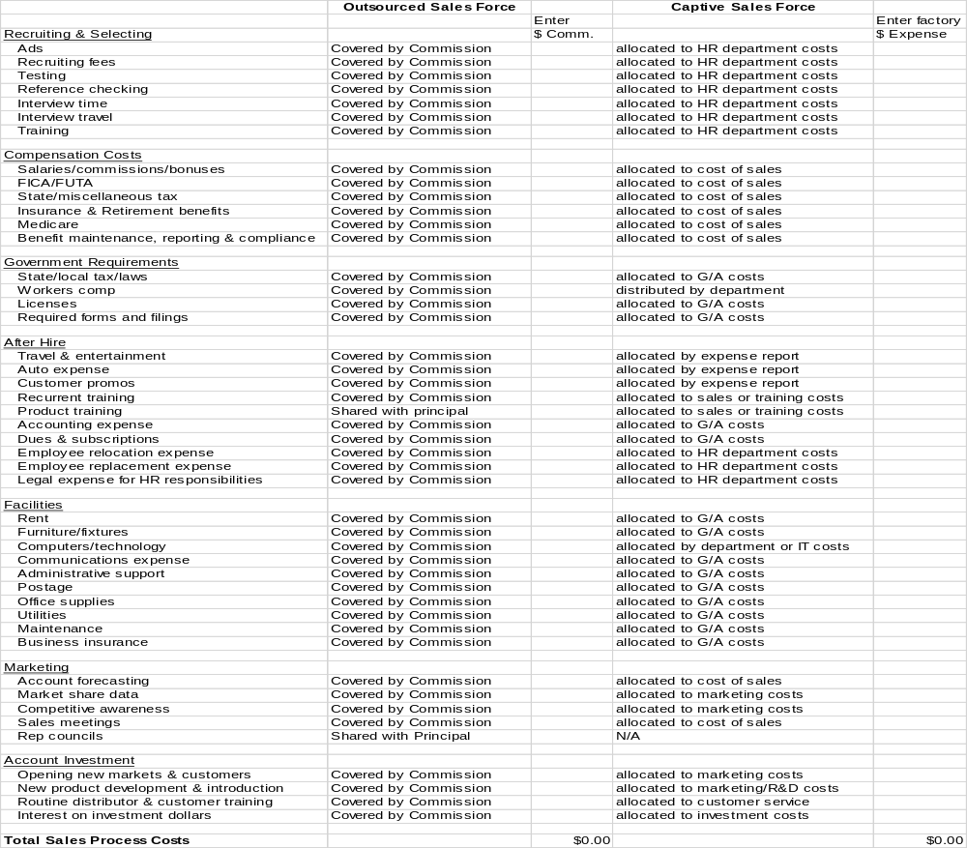
Commission
The Simple Rep Commission Covers Many Things Considered Overhead In A Direct Sales Model.
Source: The Institute For Professional Advancement
Notes:
Key point
The purpose of this slide is to highlight visually how Rep commissions cover a wide variety of expenses that would be captured as direct costs and allocated overhead for a direct sales team.

Slide 27
Typical Rep Use Of Commissions
Source – Collective Data from 12 Manufacturers Rep Organizations
Notes:
Key Points
This graph shows how a typical Rep uses Manufacturer commissions to cover various sales expenses.

Slide 28
Rep vs Direct Cost Model for a New Large Program
4 year model
Assumptions
$20mil sales in yr 3
$250k Direct OSR cost
3% rep commission
Rep recoups investment in yr 3
Rep cost becomes unfavorable in yr 4
Assumes no cap or commission scale

Slide 29
Appendix 2 - Hybrid Models
There Is Not “One Size Fits All” Sales Channel Strategy For All Manufacturers In All Situations.
In Some Cases, Exclusively Using Manufacturers’ Reps (Supplemented With Distribution) Is The Best Model.
In Other Cases, A Hybrid Model Using A Blend Of Direct Sales and Reps Is the Best, Most Efficient Approach.
  The Hybrid Sales Model Utilizes Both Direct Sales And Local Reps Working Interdependently To Allow For Sales Function Specialization And Targeted Relationship Building At Key Accounts.
Notes:
Key Points
This appendix addresses “Hybrid Models” should this come up in the conversation.
As we said that the beginning of the presentation, there is not an ideal sales channel strategy for every situation. In some cases, exclusively using Reps might be the best model. In other cases, using a blend of Rep and Direct resources may be the most efficient approach.

Slide 30
Hybrid Models
  Complementary Hybrid Model Uses Both Direct Sales and Local Reps To Provide Complete Account Coverage Of Major Customers.
      Direct Sales / Global Account Management provides…
      Dedicated Resource To Manage The Account At A Global Level
      Coordination Of Multi-site Opportunities With The Local Reps
      Aggregate Global Forecasting Between Each Site
      Lead Creation And Execution Of Global Selling And Service Strategy
      Local Sales Representation provides…
      Local Tactical Sales Team / Frequent Customer Touches
      Broader Customer Penetration
      Early Program Engagement
      Multi-faceted Resource To Customer
      Multiple Line Selling Gives More Access To More Customer Contacts And More Projects
Notes:
Key Points
This slide discusses one hybrid model – what we call the “Complementary Hybrid” model that uses both Direct Sales and Rep resources to completely cover one or more Major Accounts.
Direct Sales could provide global account management, coordination of multi-site opportunities and global demand forecasting.
Local Reps could provide tactical sales and technical support.

Slide 31
Hybrid Models
  Market Hybrid Model Uses Both Direct Sales and Local Reps Focused On Different Customer Bases
      Direct Sales Resources Focus On The Few Accounts That Truly Require Those Resources And Complex Global Coordination.
      Rep Sales Resources Support All Other Customers And Provide Market Distribution Coordination.
Notes:
Key Points
This slides discusses what we have called the “Market Hybrid” model.
In this model, a Manufacturer uses both Direct Sales and Rep resources on different customer bases.
Unlike the Complementary Hybrid model that uses Direct Sales and Reps to support various aspects of the same customer, the Market Hybrid model keeps each group focused on distinct customer bases.
In this model, Reps are often used for local Distribution support.

