Slide 1
What’s Up …
What’s New
with ERA?

Slide 2
2018 Conference
First ever SELL-OUT! Thanks and Kudos to:
  Committee Chair: Rick LaPiana
  Keynote Sub-Committee Chair: Ken Bellero
  Sponsorships Sub-Committee Chair: Dave Foster
  Breakouts Sub-Committee Co-Chairs: John Hutson and Holly Myers
  General Sessions Sub-Committee Chair: John O’Brien
  Conference Maestro: Tess Hill
  Conference Maestro-to-be: Erin Collins

Slide 3
2018 Conference
All involved, please stand!
YOU made this happen!
A high bar is set for 2019 indeed!

Slide 4
Your ERA Leadership Team
Dan Parks Chairman
Dave Norris President
Ken Bellero Manufacturer Delegate
Chris Beesson Distribution Delegate
Kathie Cahill SVP Membership
John O’Brien SVP Education
Chuck Tanzola SVP Legal
Bob Evans SVP Industry
Notes:
Ask them to stand and remain standing

Slide 5
Your ERA Leadership Team
Your Chapter Leaders/Delegates
Arizona Cameron English
Carolinas Bruce Scoggin, CPMR
Chesapeake Steve Cooper
Chicagoland-Wisconsin Jeff Huntsinger
Dixie Todd Ford
Empire State Dave Dasson, CPMR
Florida-Sunshine Seth Brock
Notes:
Ask them to stand and remain standing

Slide 6
Your ERA Leadership Team
Your Chapter Leaders/Delegates
Indiana-Kentucky Ellen Coan, CPMR
Michigan Matt Cohen, CPMR
Mid-Lantic Peter Conlan
Minnesota Cary Klingner
New England John Hutson, CPMR
New York Steve Alford
Northern California Hugh Shyba
Notes:
Ask them to stand and remain standing

Slide 7
Your ERA Leadership Team
Your Chapter Leaders/Delegates
Ohio David Gassman, CPMR
Pacific Northwest George Alecci
Rocky Mountain Jim Beam
Southern California Doug Johnson
Southwestern Jim Moore
Spirit of St. Louis Mike Long
This is your LEADERSHIP TEAM!
Notes:
Ask them to stand and remain standing

Slide 8
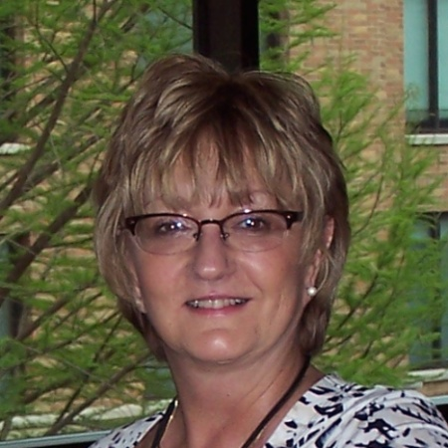
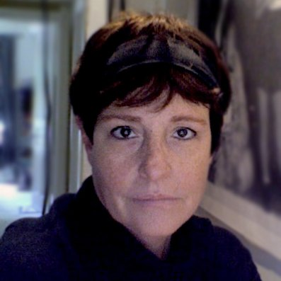
ERA’s staff:
Karin Derkacz,
Administrative Assistant/
Operations Manager
Kathy Green,
Web/Database
Administration

Slide 9
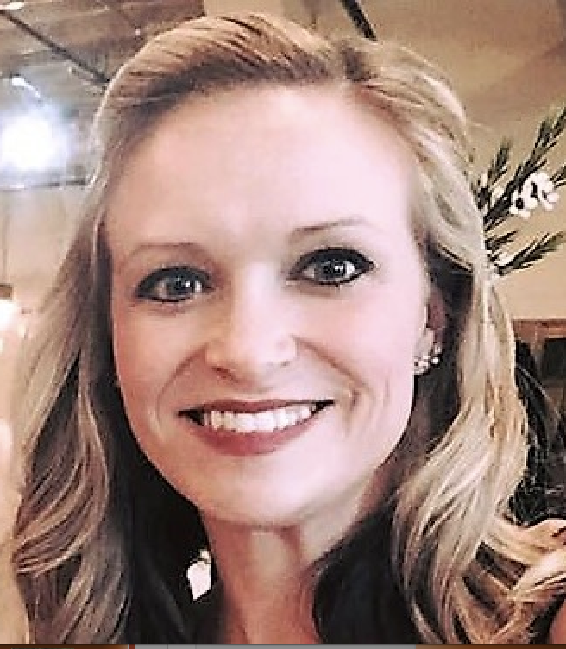
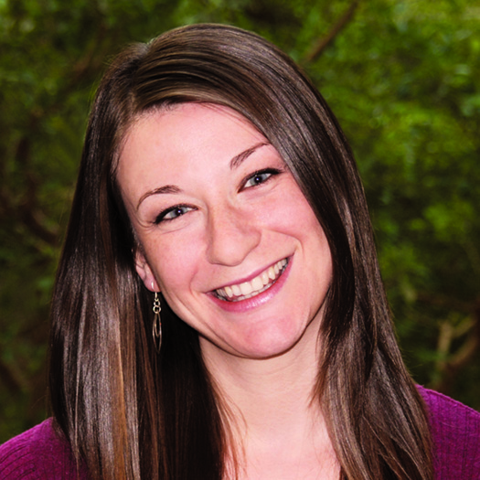
ERA’s staff:
Stephanie Tierney,
Membership
Coordinator
Neda Simeonova,
Communications
Director

Slide 10
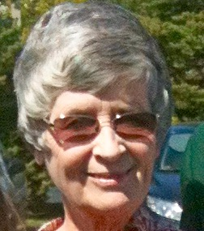
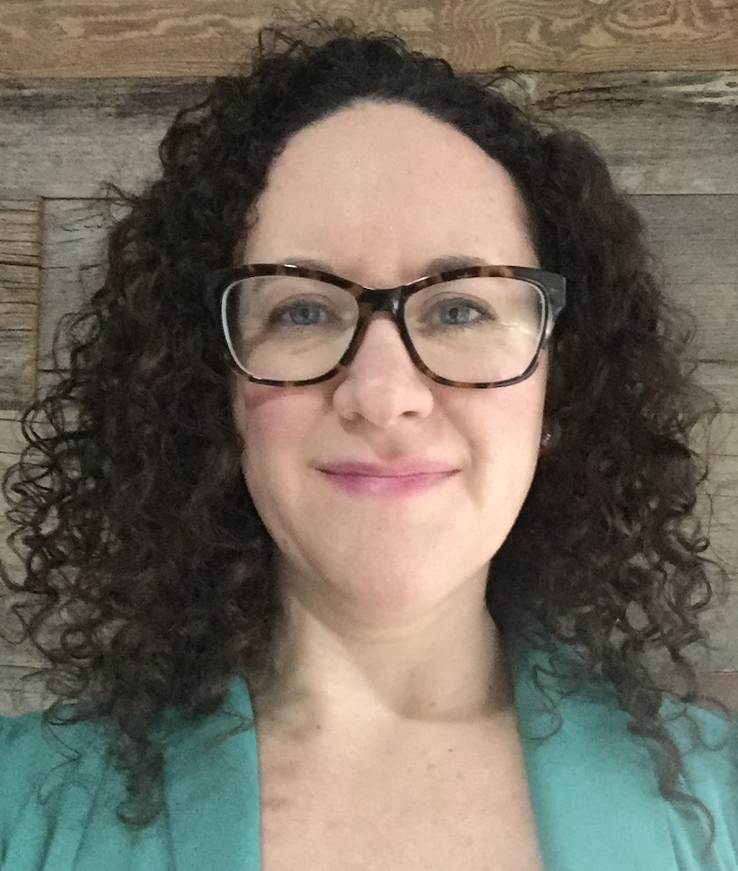
ERA’s staff:
Tess Hill,
Conference
Coordinator
Erin Collins,
Events
Coordinator

Slide 11
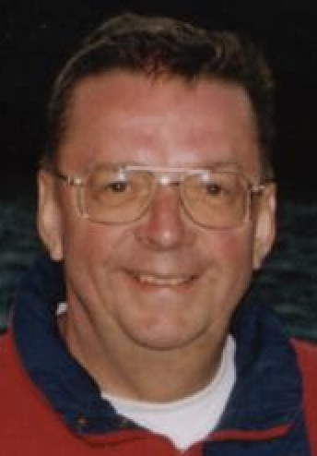
ERA’s staff:
Bill Warfield,
Director of Finance

Slide 12
Membership Update:
Membership is UP in all categories.
Almost 600 members in YOUR ERA.
Major membership drive is underway under the leadership of Kathie Cahill and Stephanie Tierney.

Slide 13
Membership Update:
Give US names and contact information for anyone you want us to approach for membership.
Our best sales team is made up of our existing members!

Slide 14
New ERA website
Visit: www.era.org
More intuitive and modern
New fresh look for ERA
Includes embedded videos
Have you “kicked the tires?”
Reset your password and go see what GREAT STUFF is in there!
Update your rep listing!

Slide 15

electronica 2018
November 12-15, Munich
ERA will be there:
Walter Tobin
John Hutson, MacInnis Group
Mark Motsinger, Wallace Electronic Sales
Holly Myers, Wallace Electronic Sales
Tom Griffin, Catalyst Sales

Slide 16

EDS Summit
May 15 – 18, 2018, Las Vegas
This is a MUST attend event!
ERA / ECIA hosted breakfast on May 17 at 6:45 a.m.
ERA Center is YOUR headquarters.
ERA Conference Room available – schedule with Karin.

Slide 17
ERA Insurance Trust … coming back?
New insurance laws MAY allow ERA to ONCE AGAIN offer members insurance across state lines.
Working with Gerry Newman and Adam Glazer on this key development.
Stay tuned!

Slide 18
New Tax Plans
Article published by Stan Herzog on Feb. 10.
Headline on Woodstock Wire on Feb. 11.
Impact on our rep members is real.
Change in deductions for T&E, etc.
Talk to your accountants!
Do not miss the windows per new regulations.

Slide 19
Chapter Activities
Strong chapter activities in 2017!
List of all activities is posted on www.era.org
Great COLT session under the leadership of Bob Evans and Stephanie Tierney
2017 COLT attendees:
  Mark Bowers St. Louis
  Peter Conlan Mid-Lantic
  Pat Ferry Indiana-Kentucky
  Robert Foertsch Metro New York
  Todd Ford Dixie
  Mario Rossetti Arizona
  Bryan Teen Carolinas

Slide 20
Chapter Activities
Over 20 entries from 11 chapters for Chapter of the Year Award consideration.,
The strength of ERA resides in the Chapters – YOU!

Slide 21
New Chapter Initiatives for 2018
MEXICO
  Inaugural meeting held Feb. 21 in Guadalajara.
  Over 50 people attended.
  Looking to establish a leadership team and complete legal process.

Slide 22
New Chapter Initiatives for 2018
CANADA
  Adam Grigor of Tech-Trek and John Grobanoupoulas of Sigma Component Design are heading up initiative.
HONG KONG
  Franky Li of Mornsun is heading
  up initiative.

Slide 23

Teleforums
Initiative headed up by Stephanie Tierney
Partnering with Nicki Weiss for over 10 years!
Great “boots on the ground” training
Facilitated by YOU – real-life executives from manufacturers, reps and distribution
Many thanks to all of the co-facilitators who have made this initiative a HUGE success!
One of the biggest differentiators of ERA!
All past teleforums are available to members in audio files on www.era.org.

Slide 24
Teleforums
2017 Schedule:
  Jan. 16: Top 2017 Business Challenges
    Mark Wachtel – SJ Associates
    Melissa Bychinski – Newark element 14
    Tom Wichert – TDK/Lambda Americas
  March 21: Operating Remotely
    Mark LaPointe – SMC Diodes
    Rick LaPiana – Cain-Forlaw
  May 25: Time and Territory Management
    John Rozanski – PEI Genesis
    Dan Hill – Newark element 14
    Joe Braun – EK Micro

Slide 25
Teleforums
2017 Schedule, continued:
  July 11: Proactively Leading Change
    John Beaver – GSA Optimum
    Todd Boyce – Quist
    Chris Porter – Digi-Key
  Sept. 19: How do you Introduce a New Supplier to your Customer?
    Mike Longano – Millennium Technical Sales
    Amy Hain – RFMW
    Bill Romick – DNA Group
  Nov. 14: Goal Setting for 2018
    Don Higley – JEBCO
    Jessica Zhang – Super PCB

Slide 26

Teleforums
2018 Teleforum Outline:
Feb. 15: Your Digital Image in Today's Selling Environment
  Steve Cholas – Industry Media Expert
  Barbara Jorgensen – Managing Editor at Electronics Purchasing Strategies
  Penny Hoglund – AEM Group
April 19: How Do You Find Customers in New Markets?
June 21: Reviewing Your 2018 Goals
Aug. 2: Effective Professional Development
Oct. 11: Evaluating Your Product Offering
Dec. 6: Topic to be determined

Slide 27

The Representor
New look and feel
Hard copy and online
New columns:
  ‘Off the Shelf’
  ‘From the Floor’
This is YOUR voice to the industry.
We are always looking for aspiring authors!

Slide 28

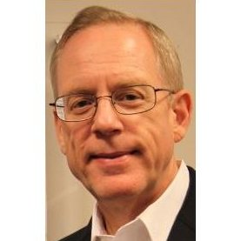
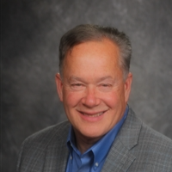
A warm welcome to Charley and all of the MANA members here today!
Charles M. Cohon, CPMR
Certified Association Executive (CAE)
CEO and President
John Beaver
Chairman of the Board
GSA Optimum

Slide 29

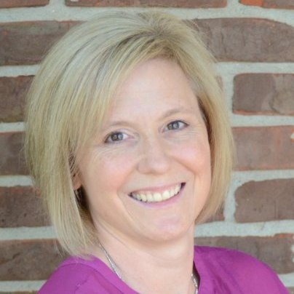
Founded in 1984 via $250,000 funding from ERA White Pin Members.
Key programs offered:
  Certified Sales Professional [CSP]
  Certified Professional Manufacturers’ Representative [CPMR]
  Manufacturers Best Practices [MBP]
ERA encourages its members to participate in this valuable training.
See Kate during the Conference!
Kathleen (Kate) Rhoten, CSP
Executive Director
MRERF - Manufacturers’ Representatives Educational Research Foundation

Slide 30
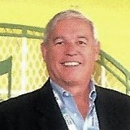

Sad to say Good-bye …
John Denslinger - CEO of ECIA
Many of us have known John for 35+ years.
Great career at Philips and Murata.
CEO of ECIA for the past five years.
A class act, always …
John’s new career:

Slide 31
In closing … ERA is YOU!
Your ERA is alive and active!
It is YOU, the MEMBERS, who make ERA great!
ERA National is here to support YOU!
My phone – 617-901-4088 – is always ON; my bags are always PACKED!
THANK YOU!

Slide 32
NON-MEMBERS:
Join ERA while at the conference and receive a $100 discount!

