Slide 1


The Evolution of the Successful Salesperson of the Future
Moderator: Holly Myers – Vice President, Genie Group
Manufacturer: Bill O’Neill– Senior Sales Manager, Sensata
Distributor: Frank Flynn– President, SAGER Electronics
Manufacturers’ Rep: Bryan Teen– Vice President, Tech Marketing

Slide 2
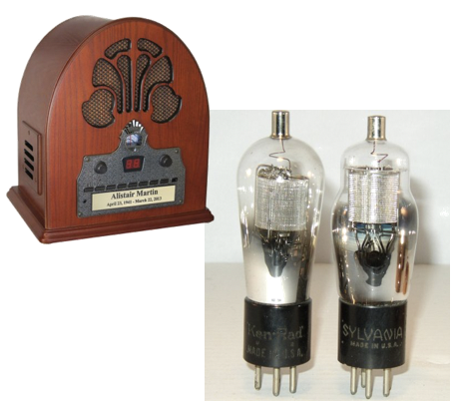
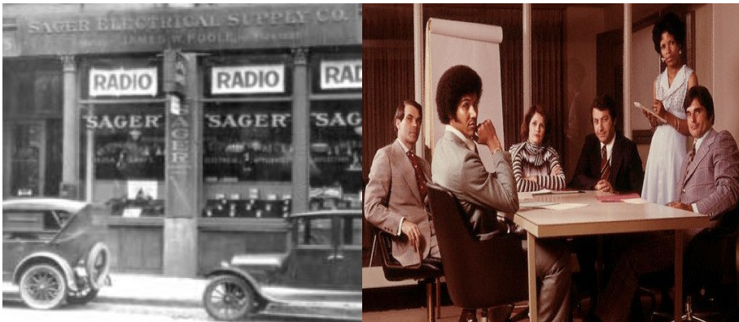
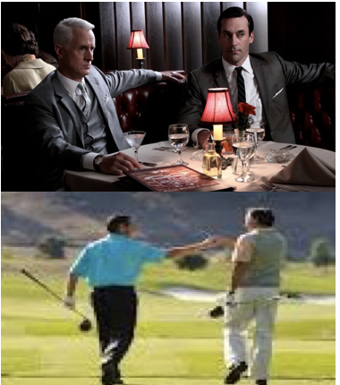
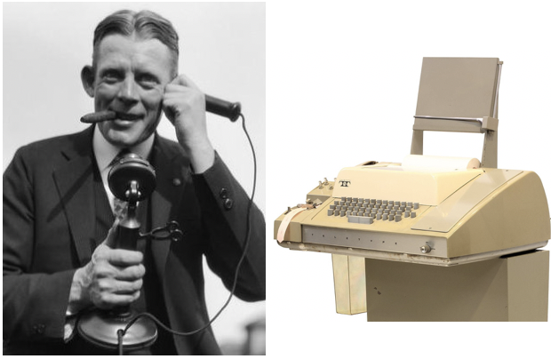
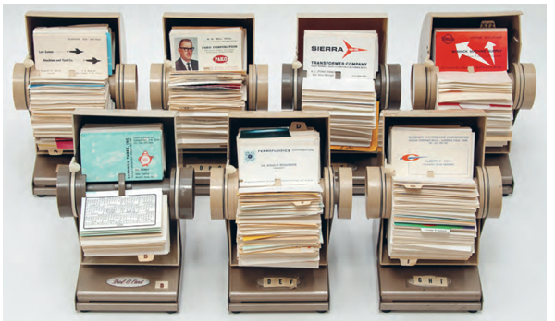
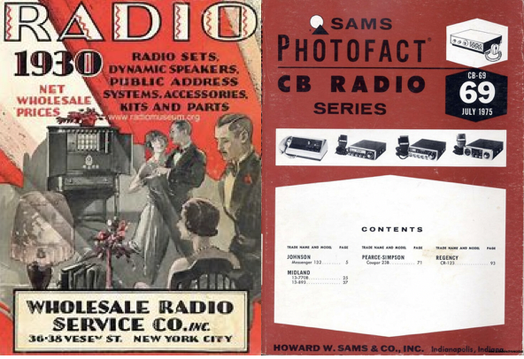
Yesterday’s Secrets for Success
Product & Application Knowledge
Building & Productive Workspace
Relationships
Communication Skills & Tools
Strong Network of Contacts
Marketing Material

Slide 3
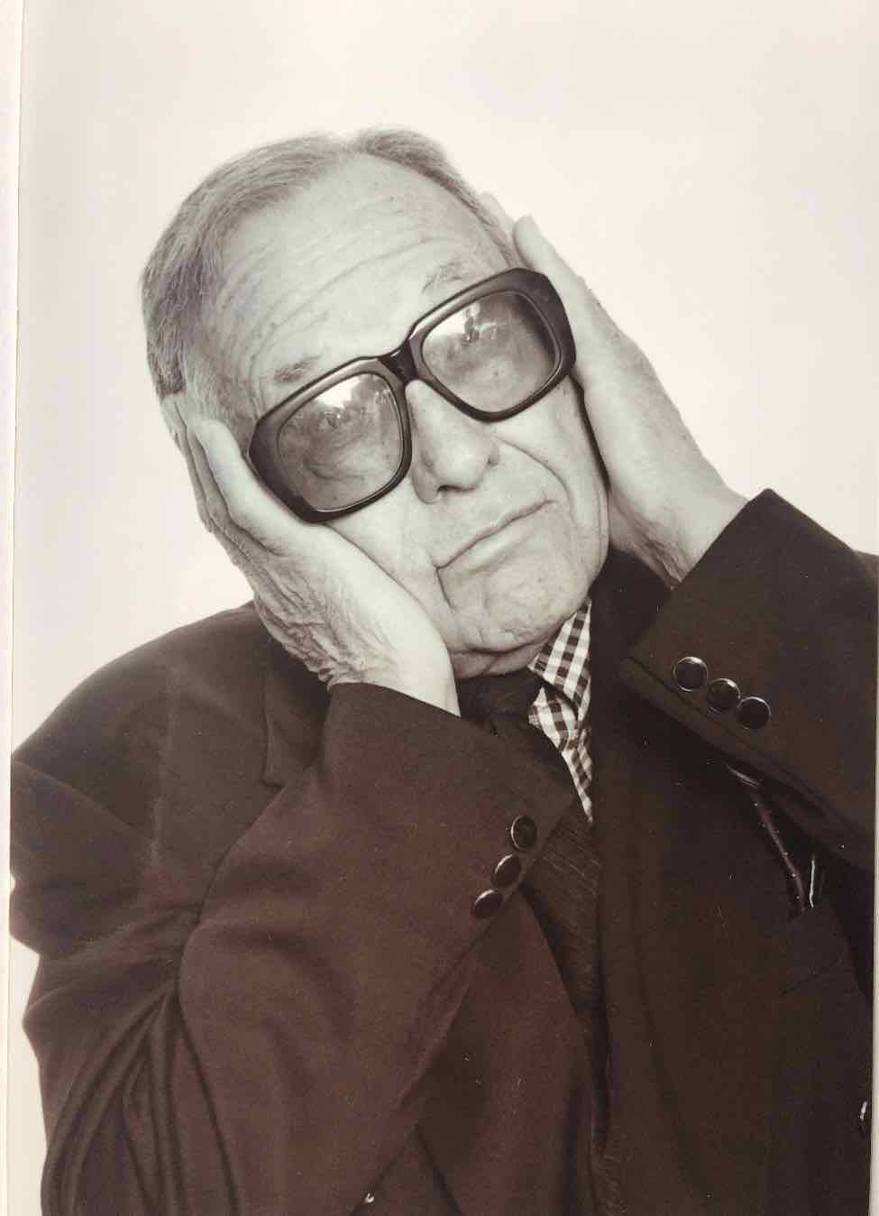
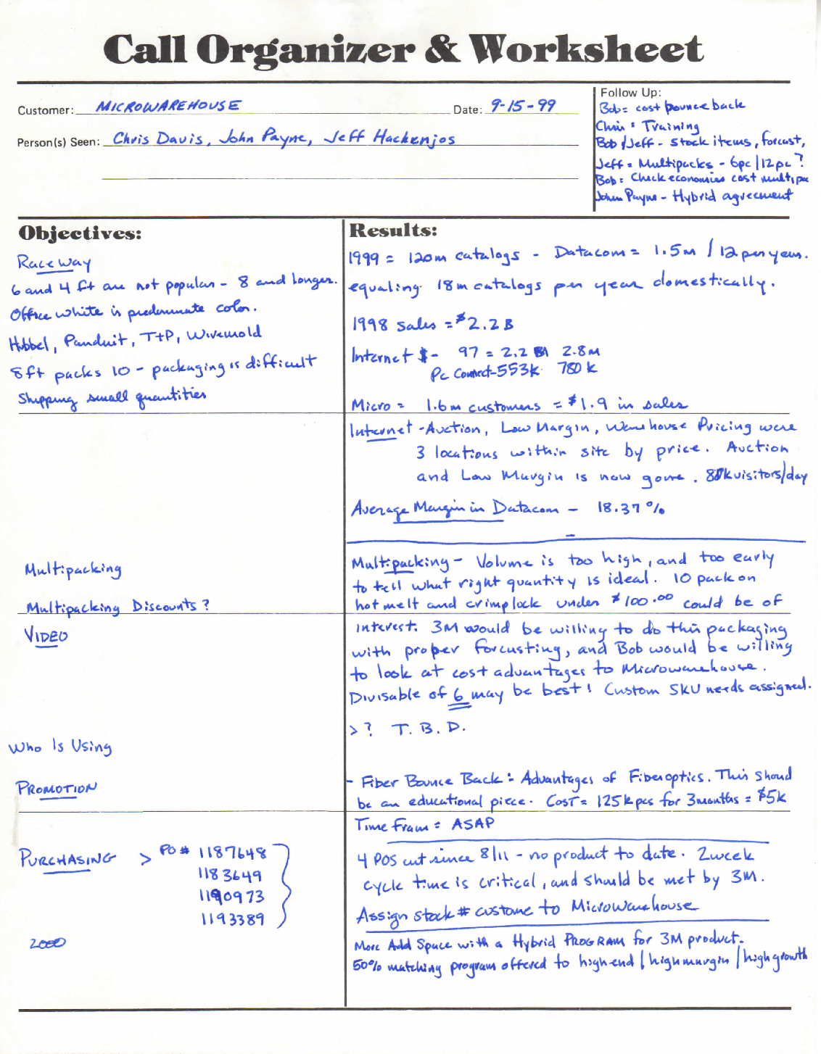
Yesterday’s Secrets for Success

Slide 4
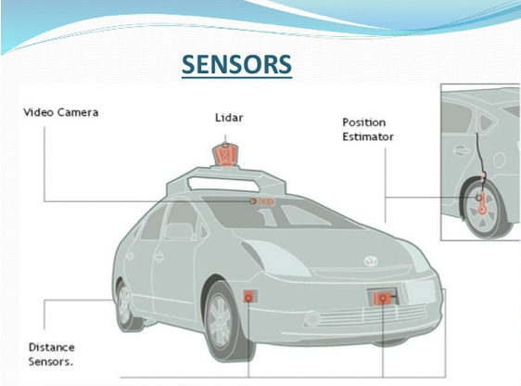
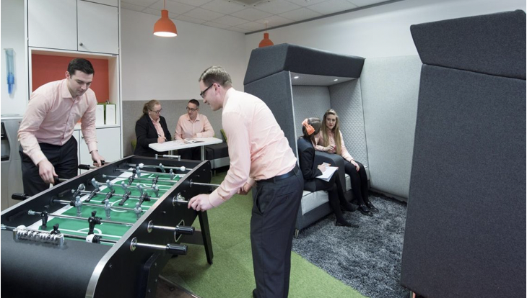
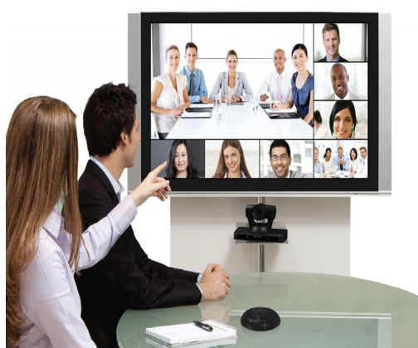
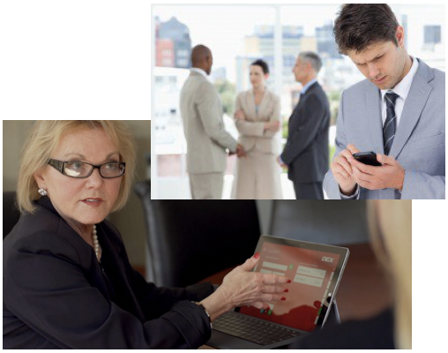


$
Product & Application Knowledge
Building & Productive Workspace
Relationships
Today’s Secrets for Success
Good Communication Skills & Tools
Strong Network of Contacts
Marketing Material

Slide 5
What Has Changed? What Has Stayed The Same?
Internet
Technology
Globalization
Marketing
Generational Differences
Facetime with Customers
Startups

Slide 6
Take-Aways
Expertise - Strategic Thinking
Expertise - Relationships
Expertise - Communication
Expertise - Time Management
Expertise - Knowledge
Expertise - Technology
Expertise - Creative Selling

Slide 7
TEST
Thank You

