Slide 1




STANDING FIRM:
REPS DESERVE TO GET PAID
Gerald M. Newman, Esq.
Adam J. Glazer, Esq.
Schoenberg Finkel Newman & Rosenberg, LLC.
222 South Riverside Plaza, Suite 2100
Chicago, IL 60606-6101
(312) 648-2300
Gerald.Newman@sfnr.com
Adam.Glazer@sfnr.com
www.NATIONALSALESREPATTORNEYS.com
www.SFNR.com

Slide 2

Why Even Consider Pursuing
My Unpaid Commissions?
Don’t want a reputation of fighting w/principals
Contract doesn’t provide for post-termination commissions
Contract gives either party right to terminate (on 30-days notice)
Might face counterclaim
Principals have much deeper pockets

Slide 3

Consider William Stein
Sales rep for Malden Mills, Inc.:
  Entered into Oral Contract
  Stein claims handshake deal was to pay 5% on all sales, and on all reorders for as long as customers purchased same styles
  No agreement on how long relationship would last, or what happened upon termination
Notes:
Mr. Stein had 40 yrs. experience in upholstery industry. Malden Mills wanted to enter upholstery business. Beyond that, the facts were in dispute. Rep claimed agreement was to pay 5% on all reorders of same style no. as products he sold.

Slide 4

Stein’s Relationship with Malden Mills
  After oral contract, Stein sells fabric over the next year to customers, and would then receive reorders for these goods
  Builds up Malden’s upholstery business to multi-million dollars in annual sales
  The predictable result?
  Termination.
Notes:
Malden Mills asserted termination was due to inadequate penetration of market.

Slide 5

Stein v. Malden Mills, Inc.
  MALDEN’S VERSION
  Understood trade practice to require payment on reorders in the door at time of termination
  Agent who entered into oral agreement lacked authority to contract for reorder commissions after termination
  Contract is too vague, indefinite and uncertain to be enforceable
  Stein can’t prove he procured post-termination reorders, and we paid others
Notes:
Although Malden’s agent had authority to enter into oral contract, he did not have authority to agree to pay commns. on reorders. Malden paid commissions to other salesmen after terminating Stein.

Slide 6

Stein v. Malden Mills
  THE EVIDENCE AT TRIAL
Stein testified that same goods would typically be ordered for 3 years, so Malden stipulated to a 3-year period
Malden exec testifies trade practice was to pay on sales made and orders received pre-termination
  Cross-exam showed exec had no knowledge of industry
Another Malden rep testified he had same arrangement as Stein
Notes:
As of time of trial, customers were still ordering same goods. At trial, Malden and Stein agree to limit damages to 3 yrs. from date of contract. Questionable move for Malden to agree to a 3-year period. (I wasn’t his counsel.) (Malden also argued that Stein had duty to mitigate damages.)
Maldon’s argument that K agreed to by one w/o authority to pay reorder comms. belied by 2nd rep w/same deal. Ct also found this was not unusual.

Slide 7

Stein v. Malden Mills
  THE JUDGMENT
Court finds Malden’s claim that contract did not include reorders is not credible
Nothing unusual about paying on reorders, “esp in light of the fact that all selling costs fell upon plaintiff”
And if reorders are in play, they are commissionable “based on the premise that they continued to flow from the original procuring cause”
Notes:
Court also found Stein had no duty to mitigate; he fully performed under K. This isn’t like terminated employee who may have duty to look for other employment. And other payments were irrelevant. Malden obligated to pay Stein under contract irrespective of other payments.

Slide 8

I. Overview of Commission Recovery Theories
A – Standard Contract Claims: Written and Oral
B – Procuring Cause Theory
C – Other Potential Avenues of Relief
Notes:
When pursuing a commission claim, always begin with K. It should (but doesn’t always) set out the rights to recover commns. during and after the K period.

Slide 9
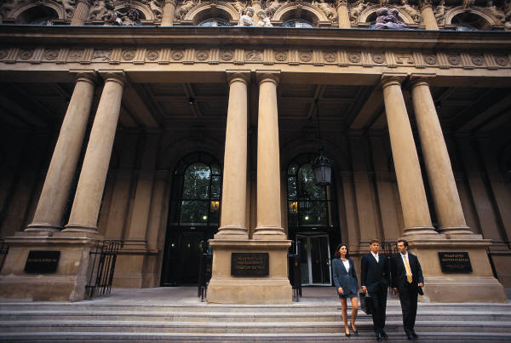
II. Actions Based on the Contract
Begin with Analysis of Rights of Parties under the Contract: What Obligations Are Imposed?
Did Principal Commit a Material Breach?
What Damages Were Suffered from the Breach?
Is a Significant and Valid Counterclaim Likely?
Notes:
Most commission recovery cases will feature a claim for breach of K. To establish a breach, must prove offer made and accepted (K), obligations breached (material), and damages resulting from breach. Cannot bring a claim based solely on a breach; must show damages caused by the breach.
Always consider threat of counterclaim, often for “failure to use best efforts.”

Slide 10

Oral Contracts Are Enforceable
Proof of terms often difficult, and subject to different statute of limitations. Sometimes disfavored.
Elements of proof are the same: offer, acceptance, consideration, breach, and damages.
Although more evidentiary problems can arise, oral agreements are valid.
Oral contract can prove better than a bad written contract.
Notes:
“You take Oklahoma for 6%.”

Slide 11
Possible Extra-Contractual Remedies
Common Law Procuring Cause Theory
Sales Rep Protection Statutes
Implied Contract
Unjust Enrichment/Quantum Meruit (if no contractual relationship)
Other potential causes of action
Notes:
We will begin by discussing procuring cause. Purpose of this legal doctrine is to prevent opportunistic termination. We are all familiar with the rep who signs a K w/30-day termination provision. Then invests his time and money into creating the demand for the product, sometimes takes years. Then, when 1st order is on the horizon, mfr. gives 30-day notice, and reaps the benefits of the rep’s years of investment in its product. Grossly unfair, so courts in many states have expanded procuring cause doctrine to sales reps.

Slide 12

The Procuring Cause Doctrine
WHAT IS IT?
Under the procuring cause doctrine, a party “may be entitled to commission on sales made after termination of a contract if that party procured the sales through its activities prior to termination.”
Notes:
Scheduling Corp. of America v. Massello, 503 N.E.2d 806, 809 (1st Dist. 1987); The Hammond Group Ltd. v. Spalding & Evenflo Cos., Inc., 69 F.3d 845 (7th Cir. 1995).

Slide 13
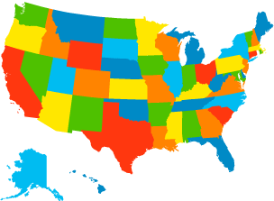
The Procuring Cause Doctrine
Common Law Doctrine enabling reps to recover commissions unless contract specifically limits post-termination rights. Varies state to state.
An equitable doctrine designed to prevent opportunistic termination by a principal.
Notes:
Derives from r.e. law

Slide 14
Termination Clause
Termination
This agreement shall commence on the date it is executed and shall continue until terminated by either party giving the other not less than 30 days prior written notice.
Upon termination, commissions shall be paid on purchase orders placed and shipments made up to the effective date of termination.
Notes:
Provides for payment of commissions up until the termination becomes effective? But then what?
Of course, certain lawyers live off clauses like this one. This only covers what happens to P.O.s placed on orders up to date of term. Says nothing about P.O.s received after term. that are procured by rep pre-term. Mfr. is not entitled to windfall for terminating rep.

Slide 15
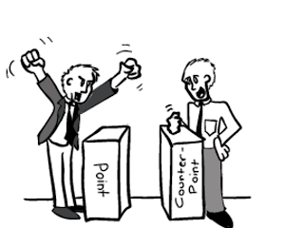
Manufacturers’ Usual Arguments
The contract says nothing about paying the Rep post-termination commissions.
Response:
It is the default rule. Doctrine applies if contract does not expressly provide when commissions will be paid.
Notes:
Will even be applied to oral contracts. Schroeder v. Meier-Templeton Assocs., Inc., 130 Ill. App. 3d 554 (5th Dist. 1984).

Slide 16

Manufacturers’ Usual Arguments
We didn’t terminate, the rep did.
Response: Doesn’t matter.
Rep isn’t procuring cause of post-termination sales. We continued calling on customer and providing services.
Response: Rep did everything it was required to do. Besides, it’s a jury question.
Notes:
(3) Arg. is that if doctrine is designed to protect rep who is terminated unfairly by principal, shouldn’t apply when rep terminates.
(4) If post-termination sales result naturally from the pre-termination work, commissionable. Principal can’t benefit from depriving rep of opportunity to perform. Ask question: What did rep not do but should have done to complete the sale? Anything other than remain the rep?

Slide 17

Manufacturers’ Usual Arguments
We paid the new rep a commission on the sales.
Response: Doesn’t affect the obligation to 1st rep (who procured the sale).

Slide 18

The Procuring Cause Doctrine:
Need Not Even Know of Sales
“an agent who was the procuring cause of the transaction is entitled to his commission irrespective of the fact that it was consummated by the principal, that he was not personally present when it was entered into, that it was consummated without his knowledge, or that he did not personally see or talk to the other party entering into the transaction.”
--Calif. Court of Appeals, 1948
Notes:
Chamberlain v. Abeles, 88 Cal.App.2d 291 (Ca. App. 1948).

Slide 19

Procuring Cause Recovery:
How Long Does It Last?
Extent of possible recovery under doctrine is not well established in the law.
In 1985 case of Scheduling Corp. of America v. Massello, principal complained that under rep’s procuring cause theory, he could receive commissions for extensions of his projects until the year 2000.
Court said to manufacturer:
Contract was freely-negotiated
Notes:
Scheduling Corp. of America v. Massello, 151 Ill.App.3d 565 (1st Dist. 1987).
Seek commissions for reasonable period of time.

Slide 20

Procuring Cause Recovery:
How Long Does It Last?
When a sales agent is the procuring cause of sales, it its entitled to receive payment for the value of its services for a reasonable period of time (per Calif. App. Ct. in Watson v. Wood Dimension, Inc. (1989))

Slide 21

Procuring Cause:
Twists and Turns
Some courts may require the rep to identify all sales for which it claims credit.
Some courts say a rep can procure specific sales only; not accounts.
Some courts have yet to apply the doctrine beyond real estate brokers.

Slide 22
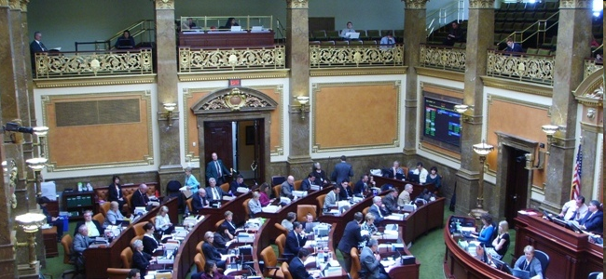
Sales Rep Protection Statutes
Most states have enacted laws to protect sales representatives who solicit orders for products.
Typically, these statutes apply to principals who:
  Do business in the state
  Use sales representatives to solicit orders for products within the state
  Compensate the sales representative in whole or in part by commission
Notes:
Rep statutes designed to level the playing field. Some states require wholesale orders, and reps who sell to end users not covered.

Slide 23

Sales Rep Protection Statutes (Cont’d)
All cover reps who are due payments of commission upon termination.
Many states impose punitive liability of 2-3 times unpaid commissions, attorney’s fees and costs for failing to pay in a timely manner.
Notes:
Punitive damages are deliberately difficult to recover. The threat of punitives often more valuable than actually seeking to recover from the judge.

Slide 24

Implied Contracts
Where parties perform as if a contract existed, courts may recognize an implied contract.
  Such as by continuing business as usual after a term contract expires.
  Or if both parties erroneously believe and rely upon the existence of a contract.
  Or if only one party performs as if the contract existed, but other party permits such reliance.

Slide 25

Unjust Enrichment/Quantum Meruit
Assuming No Contract Exists:
  a) Rep still procures sales for principal, and principal accepts and derives a benefit from such efforts, courts may find that permitting withholding of compensation (traditional commission) would be unjust
  b) Similarly, courts might award rep “as much as he deserves” for his services

Slide 26
Other Possible Recovery Theories
Specific facts may lead in other directions: anti-competitive behavior; theft; offset; fraud; negligent misrepresentation
Nothing gets their attention like a pre-trial attachment of principal’s assets
Look for means to recover attorneys’ fees in contract or in the law
Notes:
Promissory estoppel (Restraint of trade)

Slide 27

Discussion
Questions and Answers

Slide 28
STANDING FIRM:
REPS DESERVE TO GET PAID
Gerald M. Newman, Esq.
Adam J. Glazer, Esq.
Schoenberg Finkel Newman & Rosenberg, LLC.
222 South Riverside Plaza, Suite 2100
Chicago, IL 60606-6101
(312) 648-2300
Gerald.Newman@sfnr.com
Adam.Glazer@sfnr.com
www.NATIONALSALESREPATTORNEYS.com
www.SFNR.com

