Slide 1

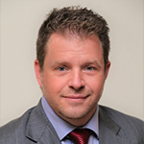
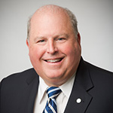
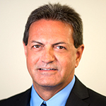
  Supporting Your Team from Inside Out
  Panelists
Alan Ahern
President
Crowley Associates
Bob Gourdeau
Vice President of Sales
for The Americas
AVX
Mark Simon
Vice President of Sales
Allied Electronics

Slide 2
TEST
  Supporting Your Team from Inside Out
“Inside Sales” Models
                Definition?
                Past
                Present
                Future

Slide 3
  Supporting Your Team from Inside Out
Demand Identification
Roles & Expectations
MFG – DST - REP
Demand Creation
Roles & Expectations
MFG – DST - REP
Demand Fulfillment
Roles & Expectations
MFG – DST - REP
Sales Process Roles/Expectations

Slide 4
Scalable Models for MFG, DIST, and MREP
Outside
Sales
Inside
Sales
Outside
Sales
Inside
Sales
Outside
Sales
Inside
Sales
Inside
Sales
Outside
Sales
No
Sales
Balanced
Traditional DIST
Heavy OS
Traditional REP
Heavy IS
Traditional MFG
No OS
Online DST, MFG
No IS
REP, MFG
No Sales
On Line MFG

Slide 5
Supporting Your Team from Inside Out
Best Practices
Leads
Requests for Quote
Technical Support
Field Sales Support
Expedites
Channel Support
  Manufacturer to Rep & Distributor
  Rep to Distributor & Manufacturer
  Distributor to Manufacturer & Rep

Slide 6
Questions?
Comments?

Slide 7
Take Aways
What are you going home with?

Slide 8
Thank You!

